Slide 1
Education after COVID19
Manuel Mazzara, Innopolis University
November 2020

Slide 2
Agenda
Factory Model Education – reality or myth?
Old vs New
The fourth industrial revolution
What have we learned from COVID19?
Humanity and machines: the future of education
Conclusions

Slide 3
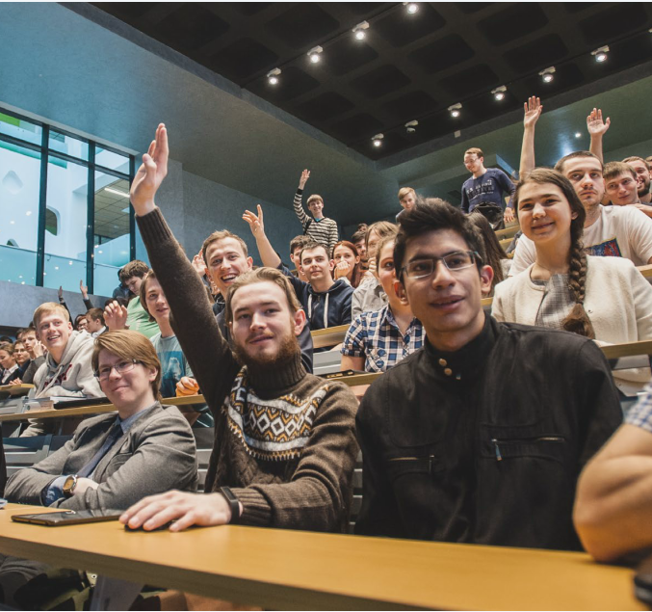
Innopolis: experimental greenfield for education
Pioneering several research and pedagogical projects
Experiments with innovative teaching methods and curricula
Quick and efficient switch to online education

Slide 6
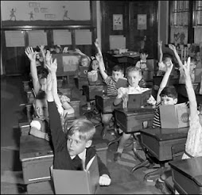
Factory Model Education
Education system emerged in Europe in the 18th century and in North America in the mid-19th century
Top-down management
Outcomes designed to meet societal needs
Age-based classrooms
Focus on producing results

Slide 7
Yes this is an arguable view of history – still we can get insights on how the current model is outdated Out-dated does not mean that we must throw everything away!

Slide 8
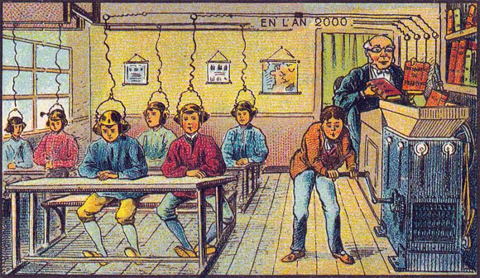

Slide 9
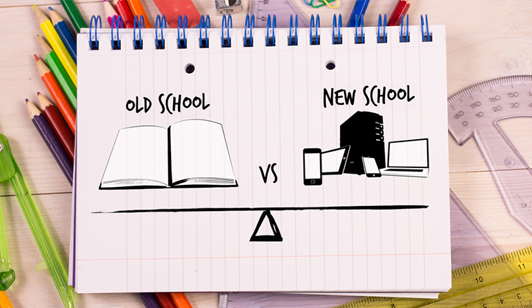
A dystopic view of the future or an opportunity for enhanced learning?

Slide 10
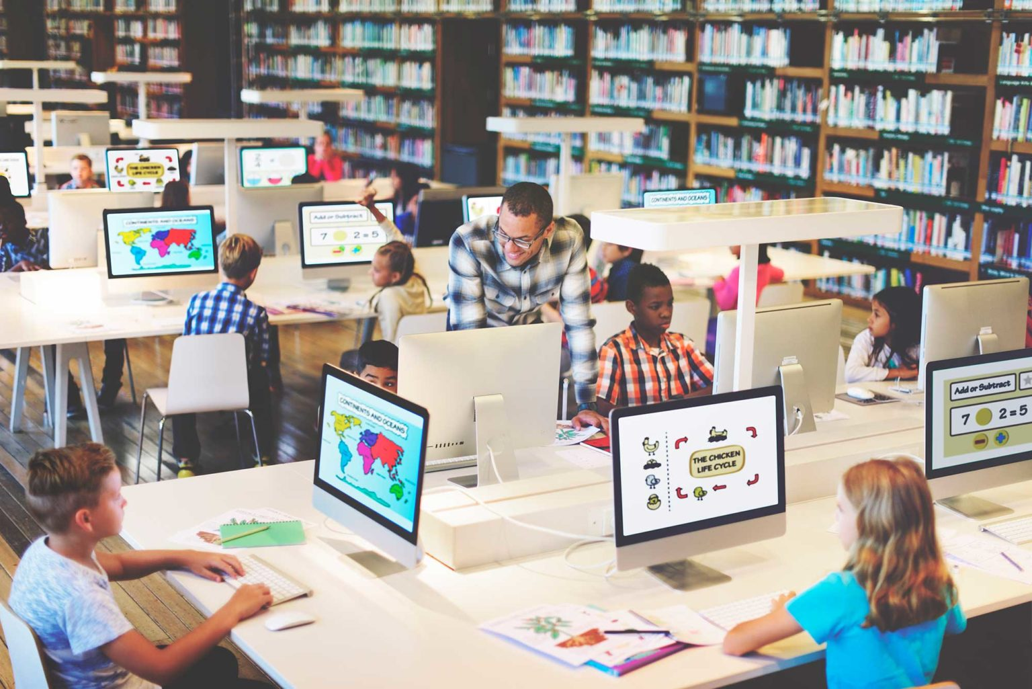
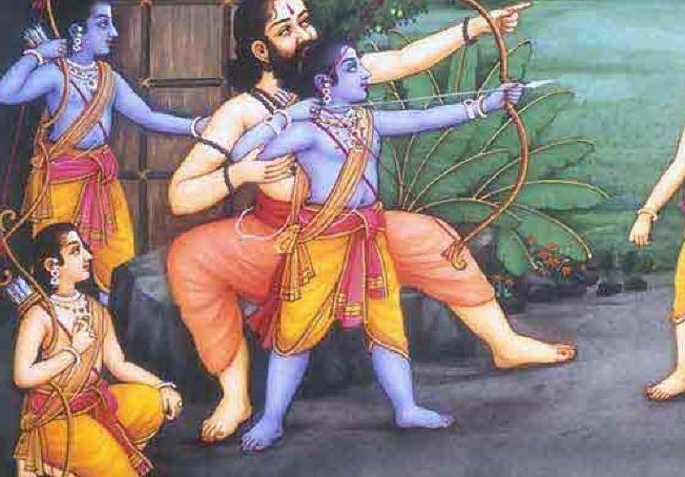
Old vs New
What elements of old and new education can we assemble?

Slide 11
The fourth industrial revolution

Slide 12
Should not this affect the way we teach?

Slide 14
What have we learned from COVID19?

Slide 15
New features of education (1)
New methods of teaching
Evaluation and assessment by virtual means
Educational programs will include digital content
Greater use of Open Educational Resources
Professional development for teaching staff on digital education

Slide 16
New features of education (2)
Distinctive features of the educational experience must compensate the decrease of campus experience
Assessments will be done regularly throughout the semester and will not solely depend on final examinations
Greater emphasis will be placed on collaborative projects

Slide 17
We had to grow fast!
From 15 to 40 in no time. Imagine how it would feel like!

Slide 18
Online education is here to stay

Slide 19
The four-move checkmate
We had no choice than teaching online
Online teaching will be encouraged
Students will demand loudly online teaching
Online education will be part of regular routine

Slide 20
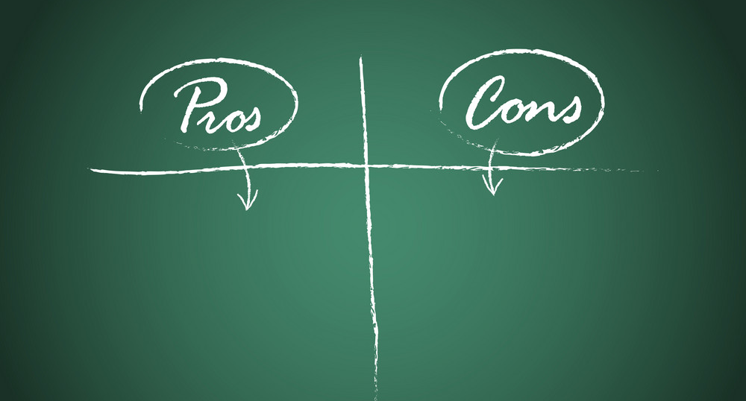
Flexible schedule
Location independence
Affordability
Accessibility
More self-responsibility
Serious discipline, both for students and teacher
Going the “lazy way” leads to actual disaster

Slide 21
Has this anything to do with AI?

Slide 22
The Turing line

Slide 23
Really?

Slide 24
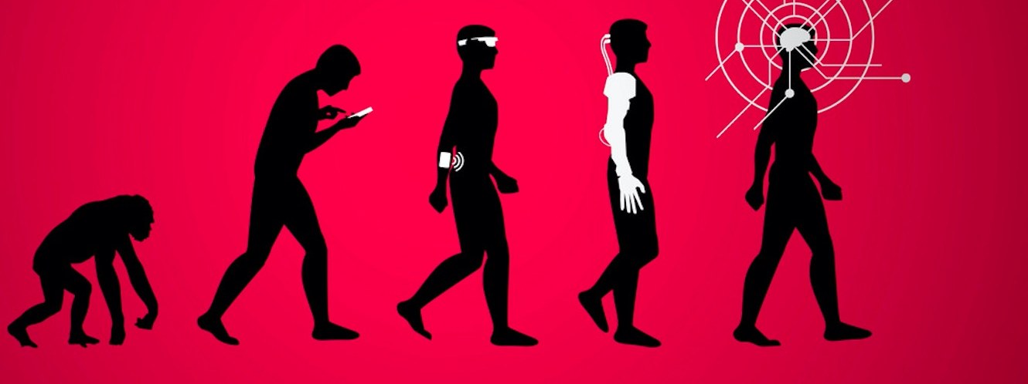
What traits of humanity and machines can we blend in the future of education?

Slide 25
Conclusions

Slide 26
Let us avoid the “student in a learning cocoon” approach – community still counts!

Slide 27
Summary
Some elements of our education system are outdated
There is a 4th industrial revolution going on
Frontal classes and practice are a millennia-old practice, cannot be (and should not be) fully replaced
What we have learned so far?
How to blend old and new for the future?
Online teaching is here to stay
Humanity and machines can work together, for the benefit of humans?

Slide 28
. . . technologies will change, particularly in such a quickly evolving ﬁeld as IT, but the principles acquired during university study, if taught without dogma and with an open mind, will remain useful

